Slide 1
Android WEAR
Programming for wearable devices

Slide 2
Wearable DEVICES
Watches
Glasses
Fitness trackers

Slide 3
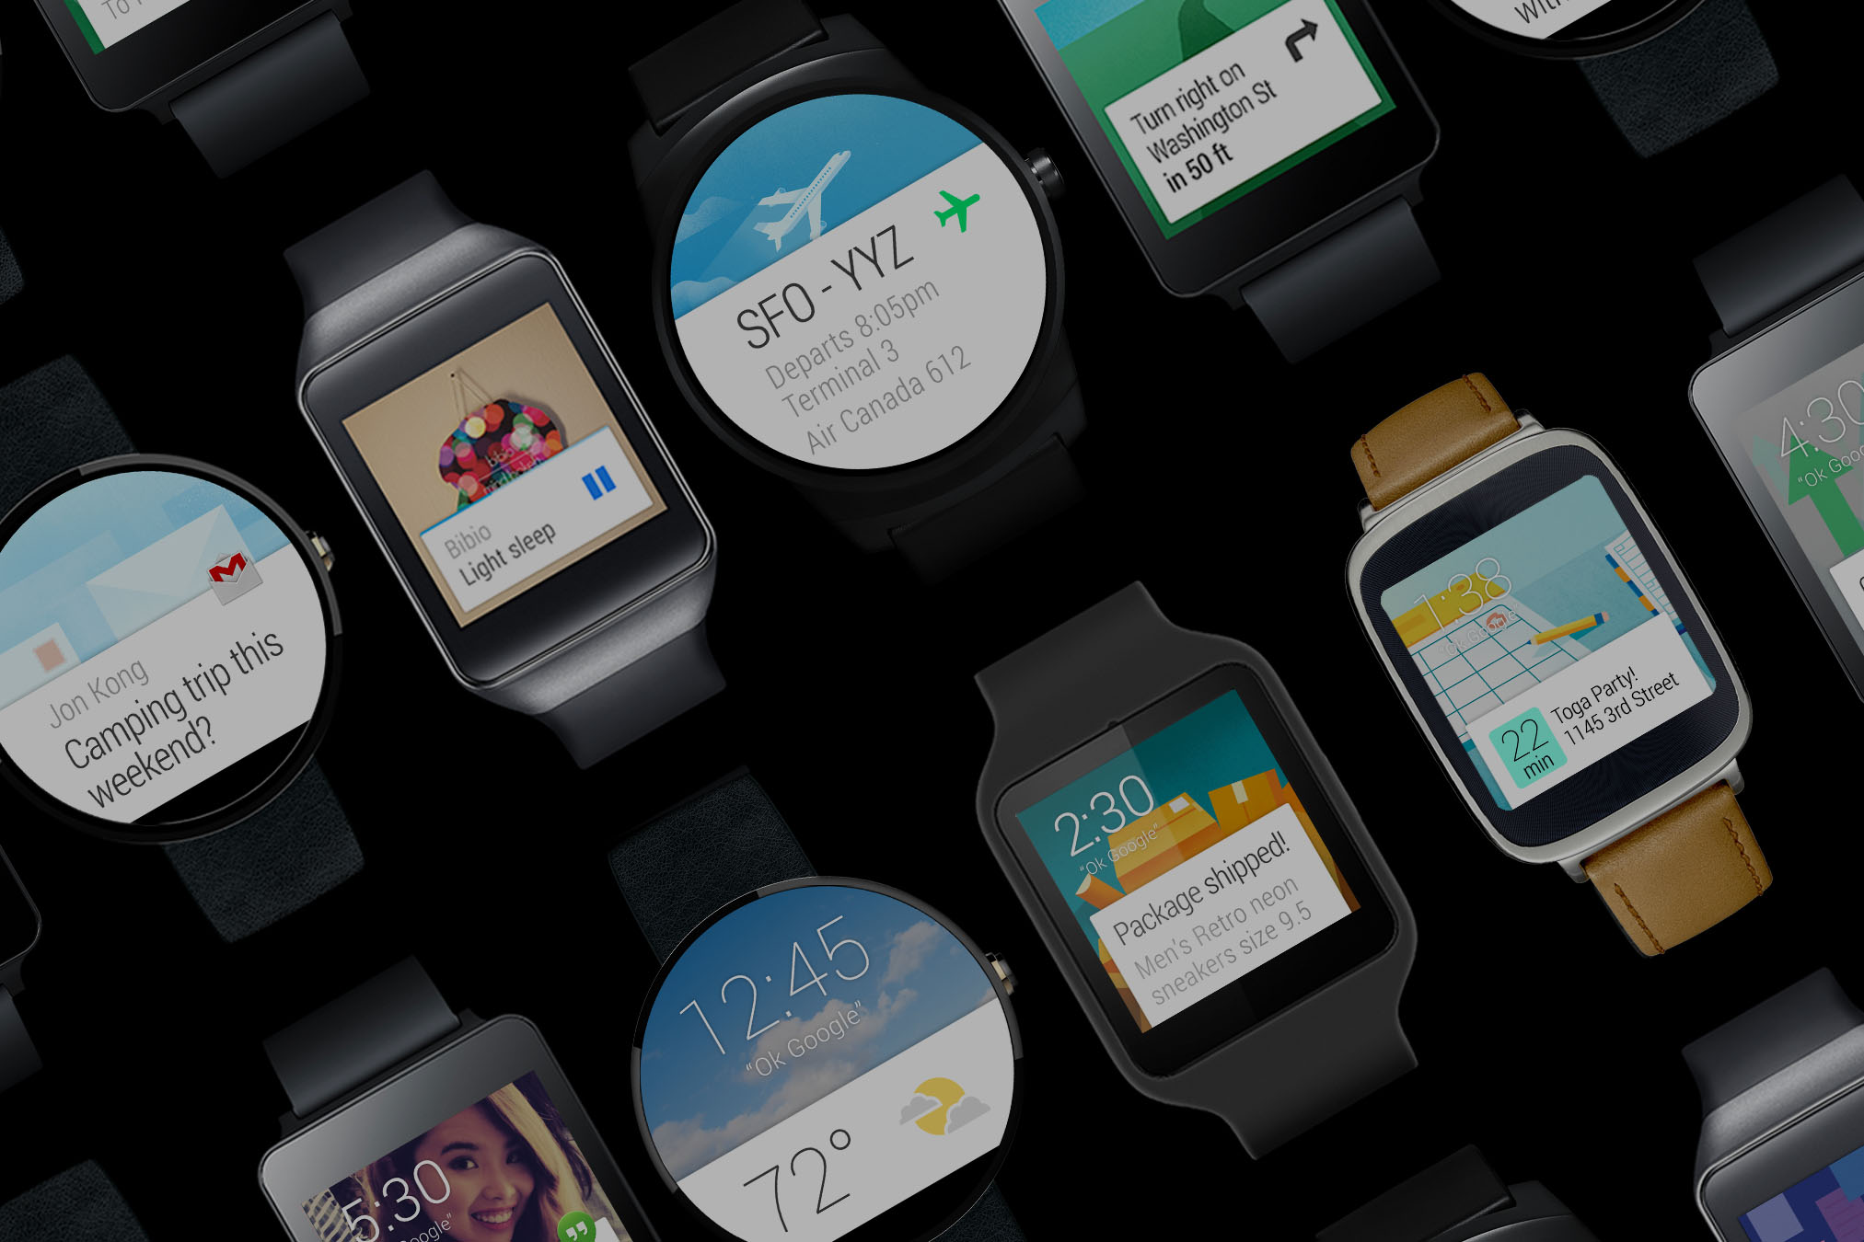
https://www.android.com/wear/

Slide 4
Agenda
Key design principles
Building apps for watches
Notifications
Creating apps for watch
Building custom UIs
Data synchronization
Location detection
Watch faces

Slide 5
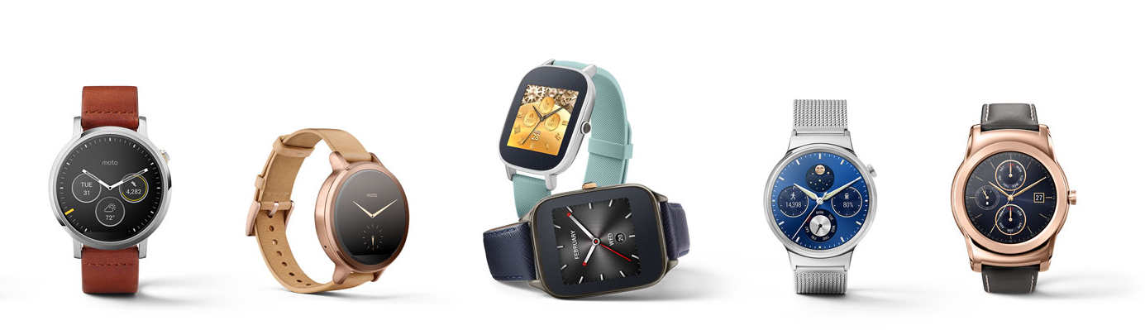
Designing apps for watch
https://developer.android.com/design/wear/

Slide 6
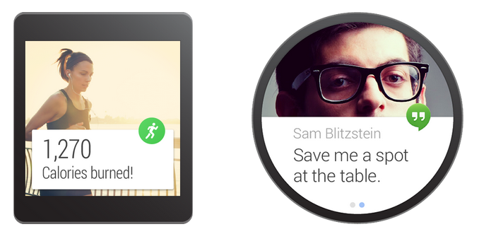
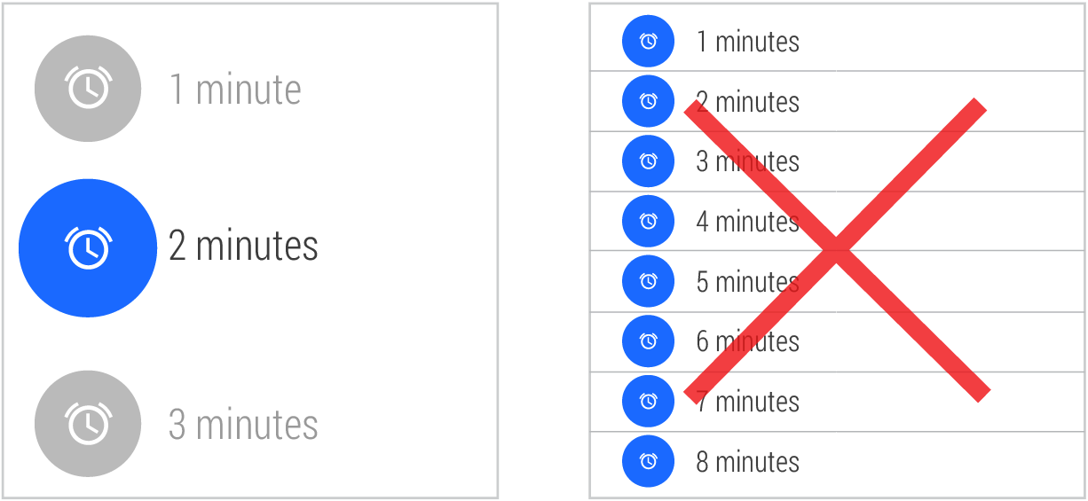
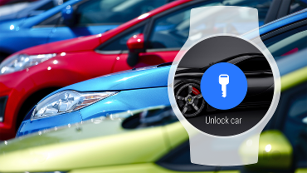
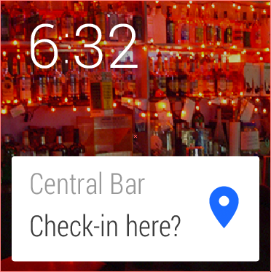
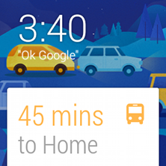
Key design principles
Stay focused
Big gestures
Stream cards first
Context awareness
Screen size
Low Information Density
Be Discreet
Notes:
Stay focused – don’t stop the user to perform an action
Big gestures – support swipes across entire screen
Stream cards first – if your app has something to say, insert a new card into a stream instead of waiting for a user to launch your app.
Context awareness – right information at the right moment.

Slide 7
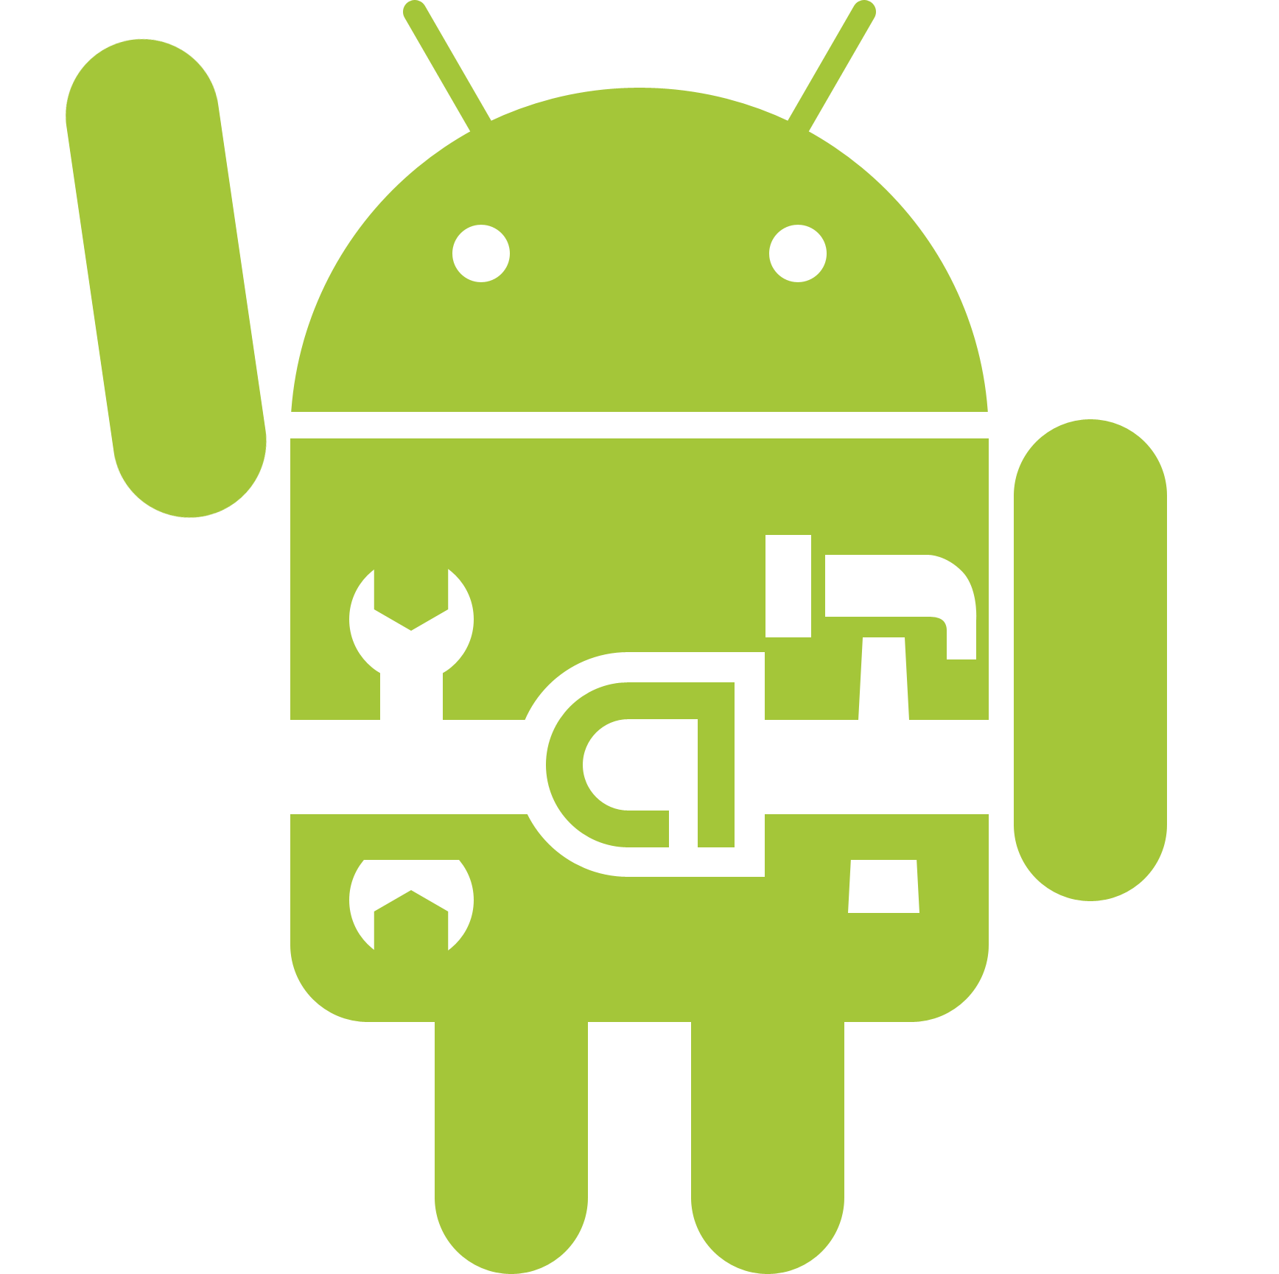
Building apps for watches
https://developer.android.com/training/building-wearables.html

Slide 8
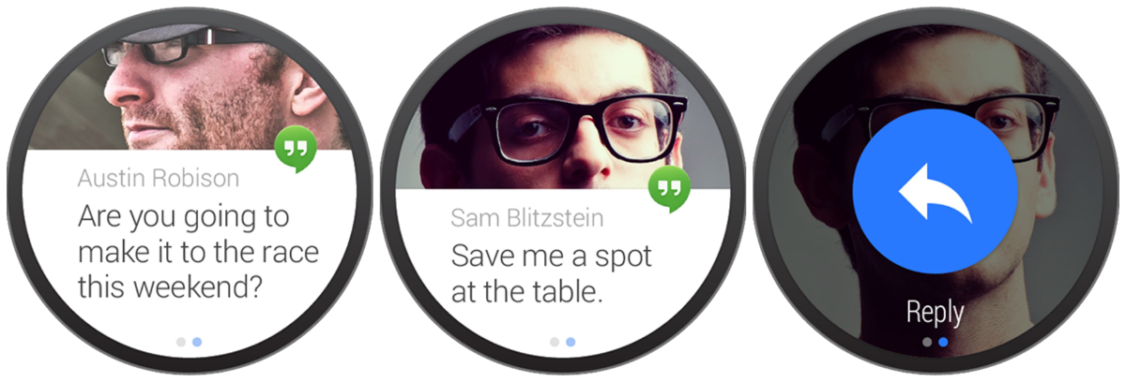
notifications

Slide 9
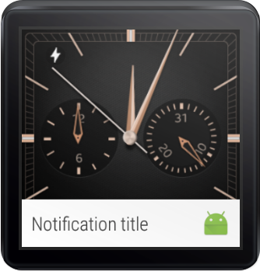
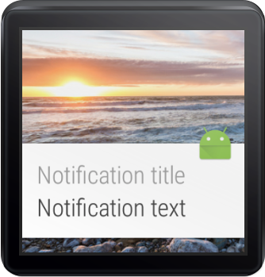
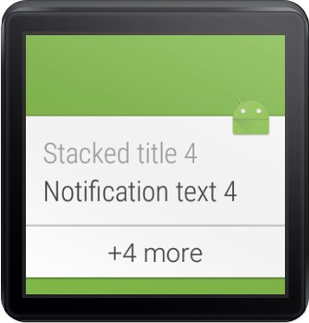
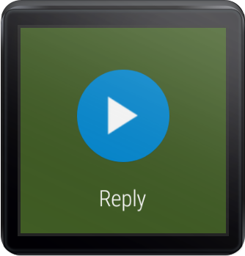
DEMO

Slide 10
WEAR APPS
Setup
Debug
Deployment

Slide 11
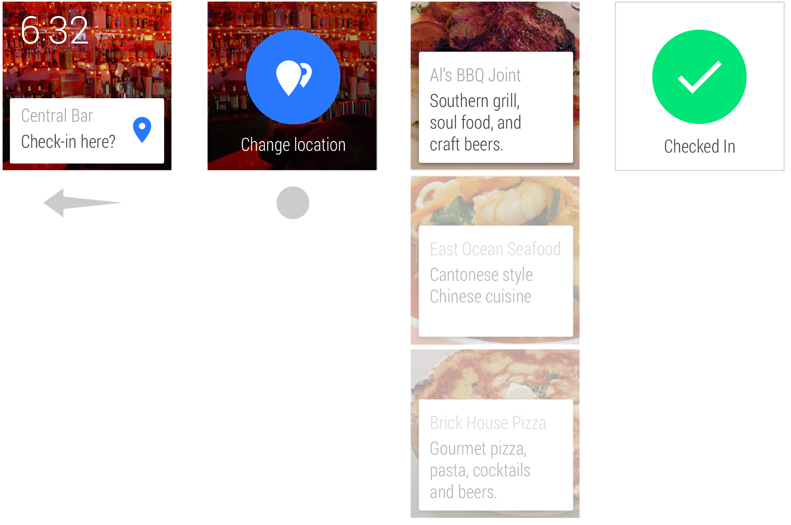
CUSTOM UI
View stubs
Card fragments & frames
Box insets
List views
2D pickers
Confirmations
“Press to Dismiss” actions
Ambient mode
+ much more…

Slide 12
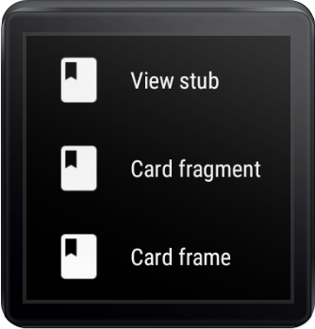
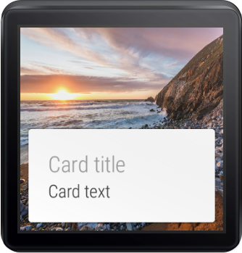
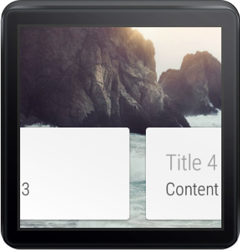
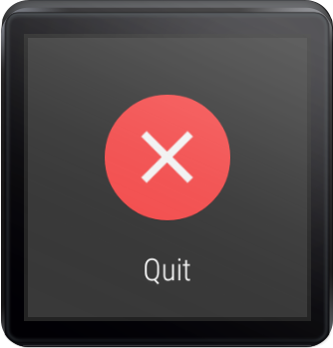
DEMO

Slide 13
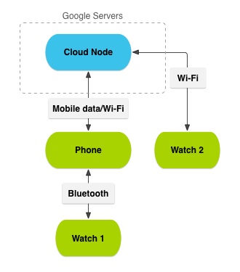
DATA SYNCHRONIZATION
Data API
Messaging API
Channel API
Node API
WearableListenerService

Slide 14
DEMO

Slide 15
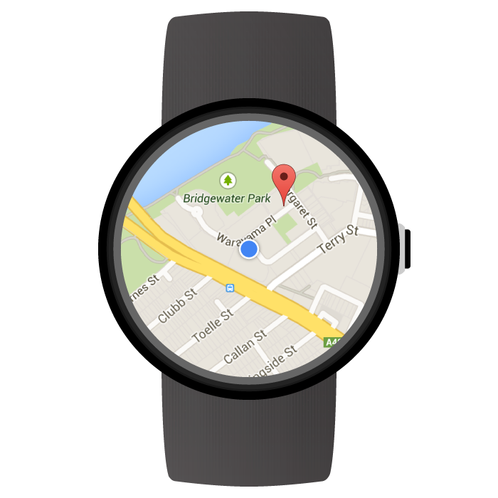
LOCATION DETECTION

Slide 16
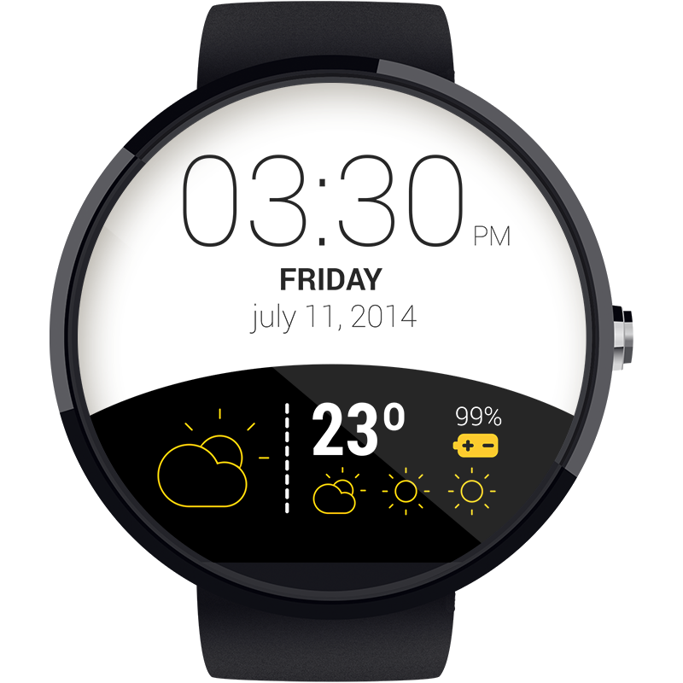
WATCH FACES
DEMO

Slide 17
Q & A
Thanks!

